Slide 1
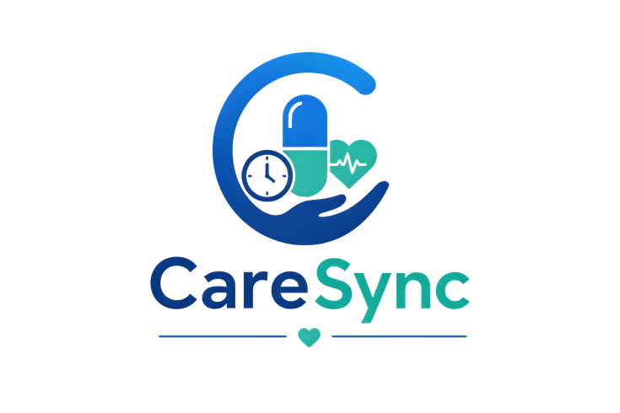
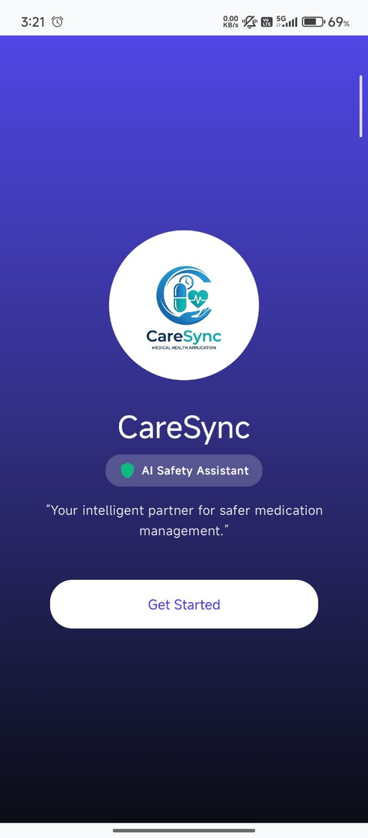
CareSync
AI-powered healthcare companion
More than a reminder app — keeping patients and families connected, informed, and safe.
AI-THON • CODEFLUX
SDGI Global University

Slide 2
2
CareSync
HEALTH
The Problem
Medication management becomes difficult when information, adherence, and emergency support are disconnected.
Medication adherence
Elders and patients can miss or forget scheduled doses, making consistent medication routines harder.
Medication understanding
Medicine instructions, uses, side effects, interactions and warnings can be difficult to interpret.
Emergency response
Patients need a simple way to alert a registered emergency contact and share relevant status.
One connected care layer can make everyday medication safer and emergencies faster.
CodeFlux • SDGI Global University

Slide 3
CareSync
HEALTH
3
The CareSync Solution
A single safety-focused platform for patients, elders and family caregivers.
1
Add & understand
Medicine details, dosage, food timing, uses, side effects and warnings.
2
Scheduled doses, Take Now, adherence tracking and Pill Organizer.
Track & remind
Gemini-powered assistant for medication and health-information questions.
3
Ask AI
SOS alerts and family/guardian connections.
4
Protect
CareSync • Solution Architecture

Slide 4
CareSync
HEALTH
4
Core Features
Built around the moments that matter: taking medicine, understanding it, and getting help.
Smart medication management
Add medicine, dosage, count, food timing, schedule and instructions.
Medicine safety information
Uses, side effects, interactions and warnings from the medicine database.
AI Assistant
Gemini-powered medication guidance with a clear healthcare disclaimer.
OCR Scanner
Scan prescriptions / medical reports or upload an image for review.
Pill Organizer
Large-print daily schedule with voice, alarm and caregiver escalation flow.
Family Care + SOS
Connect guardians for updates and trigger emergency support.
CodeFlux • SDGI Global University

Slide 5
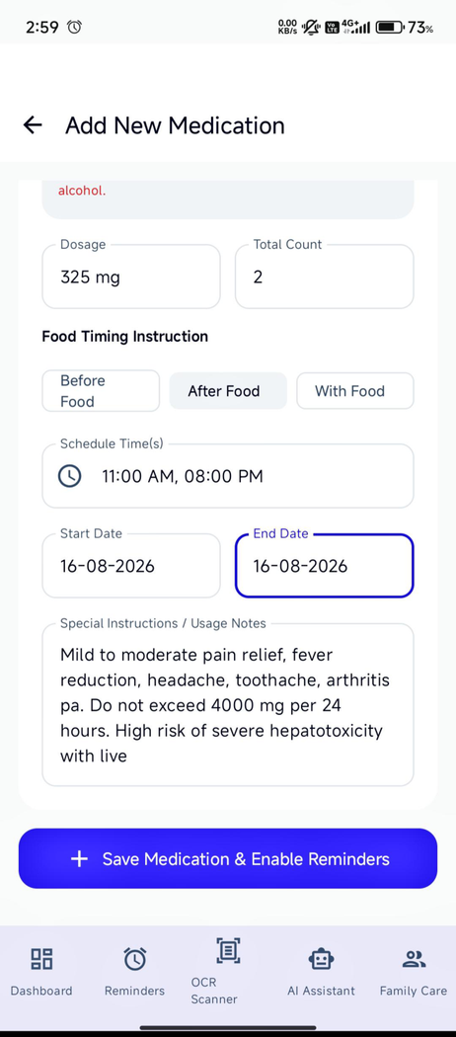
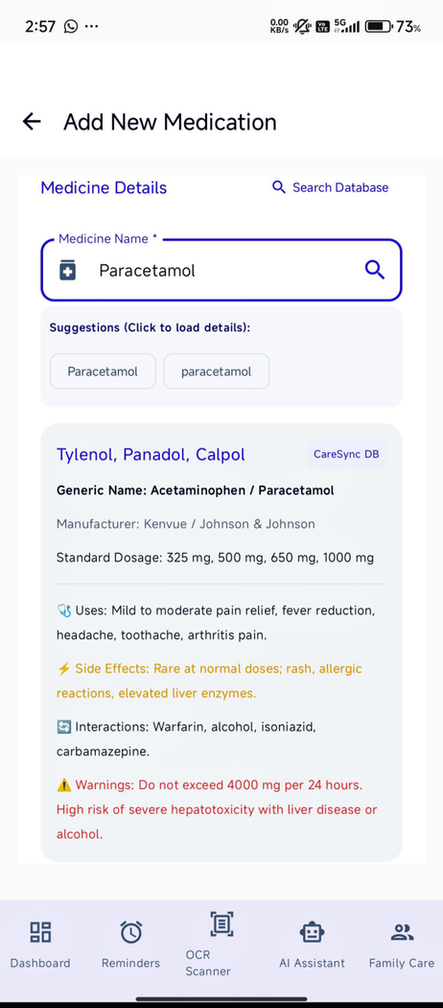
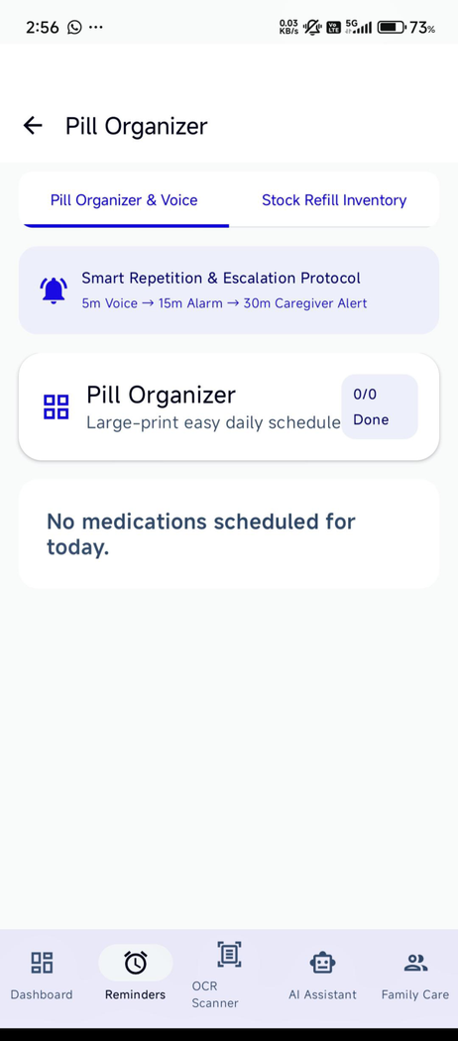
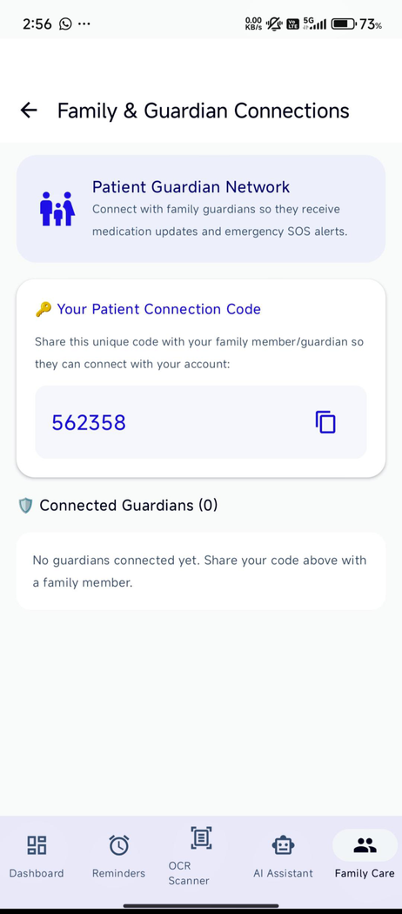
CareSync
HEALTH
5
From Medicine Entry to Safer Action
A simple workflow designed for low-friction daily use.
CodeFlux • SDGI Global University

Slide 6
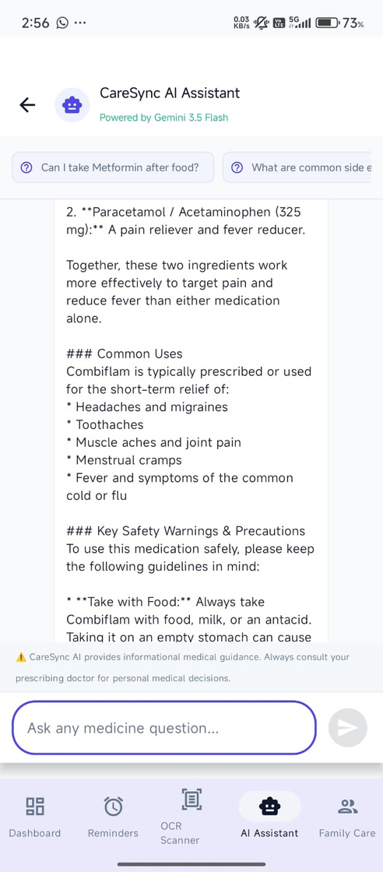
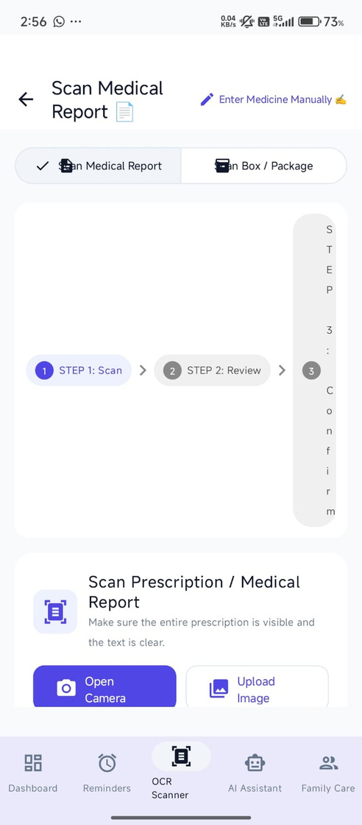
CareSync
HEALTH
6
AI + OCR: Making Medicine Information Accessible
The AI layer helps users ask questions; OCR reduces manual entry from prescriptions and reports.
AI Assistant
Powered by Gemini 3.5 Flash; users can ask medicine-related questions and receive informational guidance.
OCR Scanner
Scan a prescription / medical report with camera or upload an image, then review.
Safety by design
The app reminds users to consult a doctor for personal medical decisions.
CareSync • AI-assisted, not a replacement for clinical care

Slide 7
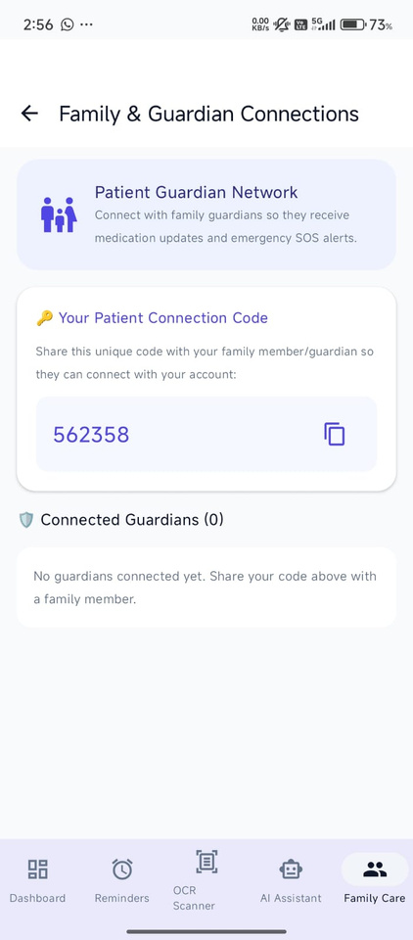
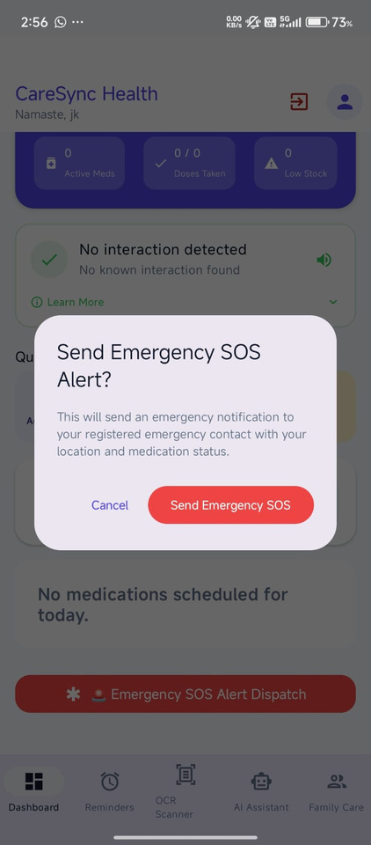
CareSync
HEALTH
7
Connected Care & Emergency Safety
Family members can stay informed while SOS provides a fast escalation path.
Family & Guardian Network
Connect guardians using a patient connection code. Guardians receive medication updates and emergency SOS alerts.
SOS
Send an emergency notification to the registered emergency contact with location and medication status.
CodeFlux • SDGI Global University

Slide 8
CareSync
HEALTH
8
Technology & Impact
A practical stack supporting a focused healthcare companion.
Flutter
Mobile application
Firebase
Backend / platform services
FastAPI
API layer
Gemini 3.5 Flash
AI Assistant
OCR
Prescription / report scanning
CareSync DB
Medicine information
Expected impact
Better medication adherence + faster emergency help.
USP
AI Assistant + Medicine Tracking + SOS in one connected experience.
CodeFlux • SDGI Global University

Slide 9




Thank You
Keeping patients and families connected, informed, and safe.
TEAM CODEFLUX
Saket Kumar Mishra
Jitesh Kumar Singh
Arpit Kushwaha
Developer
Testing
Presenter

